Slide 1
Transcriptomic Biomarkers for Predicting the Progression from Mild Cognitive Impairment to Alzheimer's Dementia
02718 Computational Medicine
Kitiyaporn Takham, Mahitha Chaturvedula

Slide 2
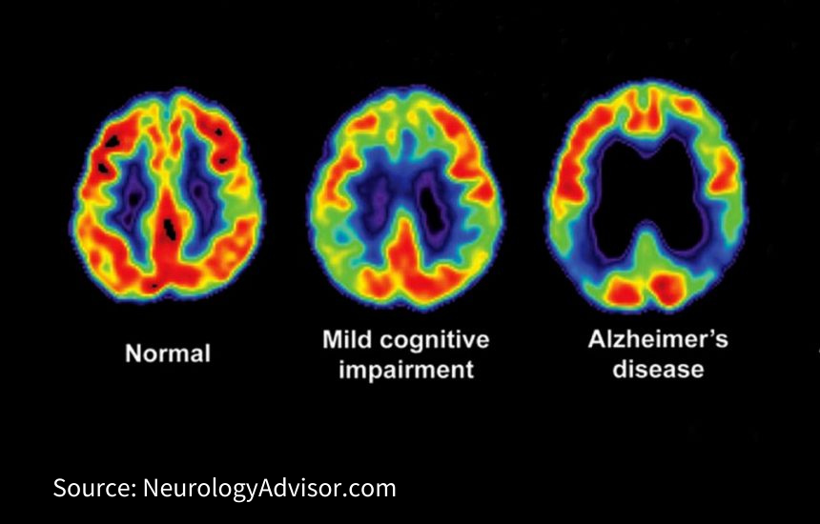
Introduction - Motivation behind project
Currently no effective treatment for Alzheimer’s Disease (AD)
Mild cognitive impairment (MCI) - initial phase of memory decline for patients and is often underdiagnosed due to its confusion with AD [1]
  MCI has been said to designate an early, yet abnormal, state of cognitive impairment [2]
By clearly defining expression markers for MCI and AD, might eliminate confusion between the two stages
  Also increase the diagnosis of both stages of dementia, leading to earlier detection and preventive medical care for dementia patients

Slide 3

Introduction - Gaps in current research
Many studies have suggested that biomarkers obtained by comparing AD to controls can be used to predict conversion from MCI to AD [3,4]
Recent studies have indicated that this change has a non-linear trajectory whereby cognitively unimpaired (CU) individuals progress to MCI, and then further progress to AD [3,4]
Recent imaging study found that molecular biomarkers predicting CU-to-MCI conversion are not as helpful as they are for MCI-to-AD conversion [5]

Slide 4
Introduction
What are we hoping to accomplish?
Aim 1: Identify a set of gene expression biomarkers for high-risk and low-risk MCI to AD dementia prognosis

Slide 5
Introduction
What are we hoping to accomplish?
Aim 1: Identify a set of gene expression biomarkers for high-risk and low-risk MCI to AD dementia prognosis
Aim 2: Compare the performance of supervised models between machine learning and deep learning approaches
SVM
CNN
Support vector machine
Convolutional neural network

Slide 6
Data
Train cohort
GEO: GSE282742
Variables: Age, Sex
- Gene expression of white blood cells (TPM), n=61860
- progressive MCI (P-MCI), n=28
- stable MCI (S-MCI), n=39
(Huang, Yi-Long et al., 2025)
External cohort
GEO: GSE249477
Variables: Age, Sex
- Gene expression of white blood cells (TPM), n=21492
- MCI due to AD, n=20
- AD, n=21
(Iga, Jun-Ichi et al., 2024)
Gene Intersection
n=21462
Normalization
Filter High Information
Cohort Gene expression: 450 genes
Notes:
Kiti: Collect genes that intersect between train cohort and external cohort
Filter out genes that low occurrence b calculating mean and standard deviation for each gene across all samples and use the mean threshold=0.5 and the std threshold=0.8

Slide 7
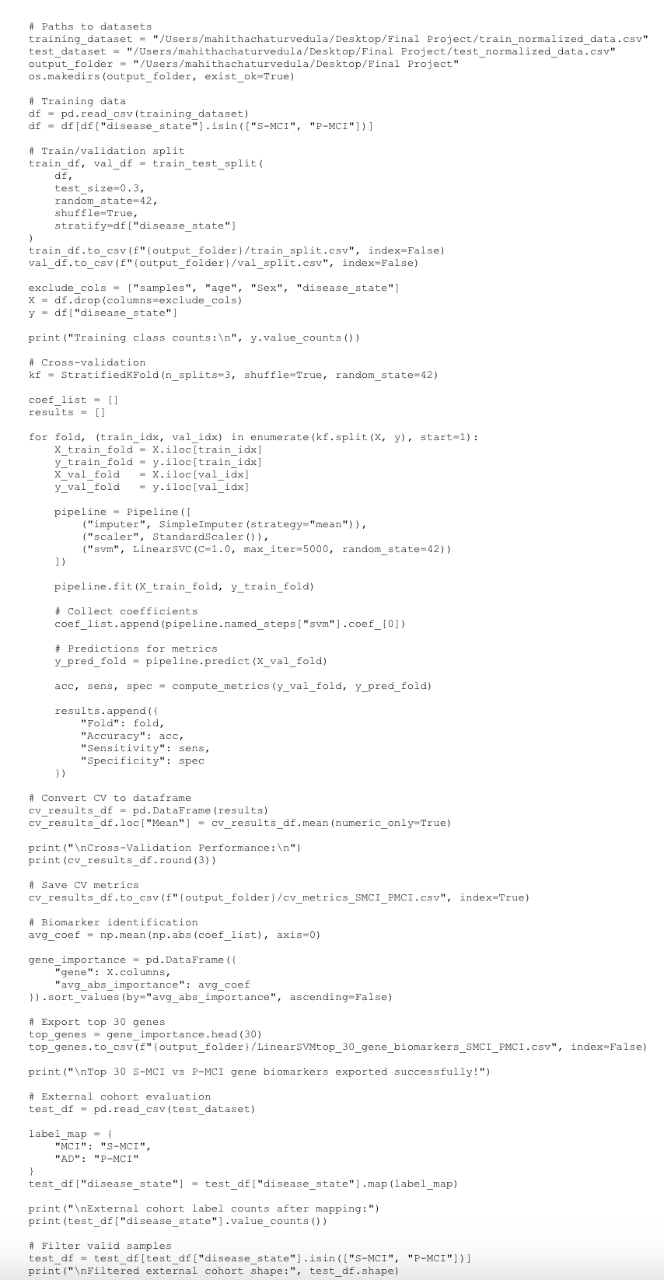
Methods -
SVM
Architecture - Scikit Learn Python library
Cross-validation: StratifiedKFold(K = 5)
LinearSVC (C=1.0, max_iter=5000, random_state=42)
Training performance
Accuracy Sensitivity Specificity
Cross-Validation Mean 0.732 0.727 0.743
Biomarker identification
Using the average absolute value of SVM coefficients
Rank top 30 genes

Slide 8
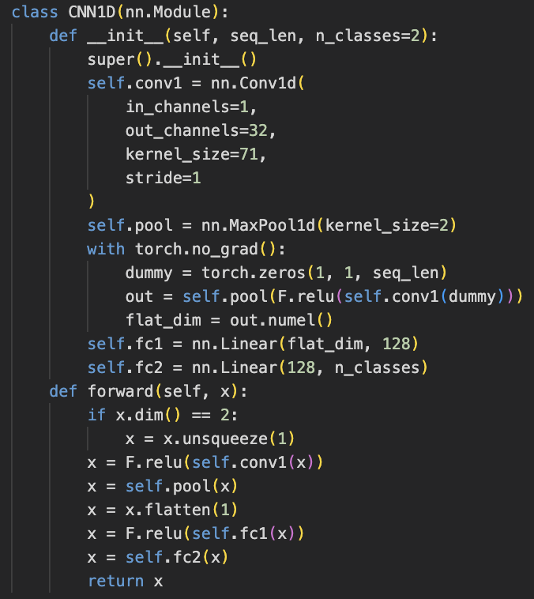
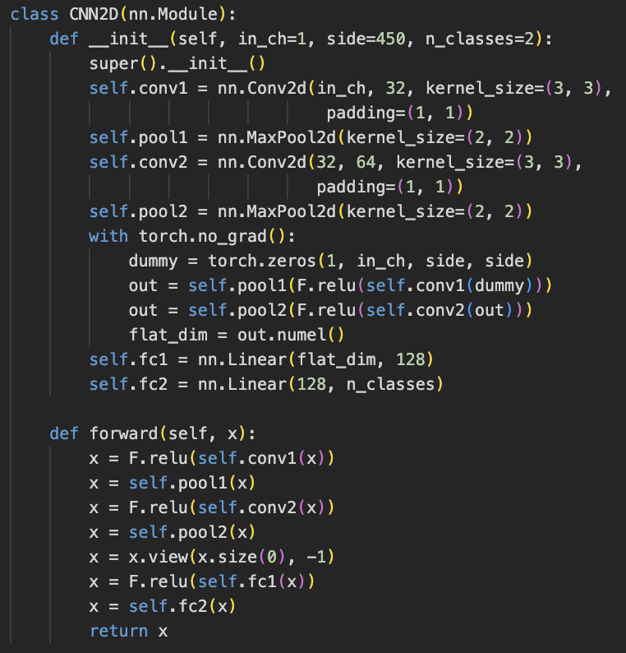
Methods -
CNN
Architecture - Pytorch
Loss function: Cross Entropy Loss
Optimizer: Adam
Hyper-parameters: lr=0.001, epoch=100
Cross-validation: StratifiedKFold(K = 5)
CNN1D() & CNN2D()
Training performance
Accuracy Sensitivity Specificity
CNN1D Cross-Validation Mean 0.642 0.367 0.850
CNN2D Cross-Validation Mean 0.688 0.493 0.818
Biomarker identification
Using the Integrated Gradients
Rank top 30 genes
Notes:
Kiti:

Slide 9
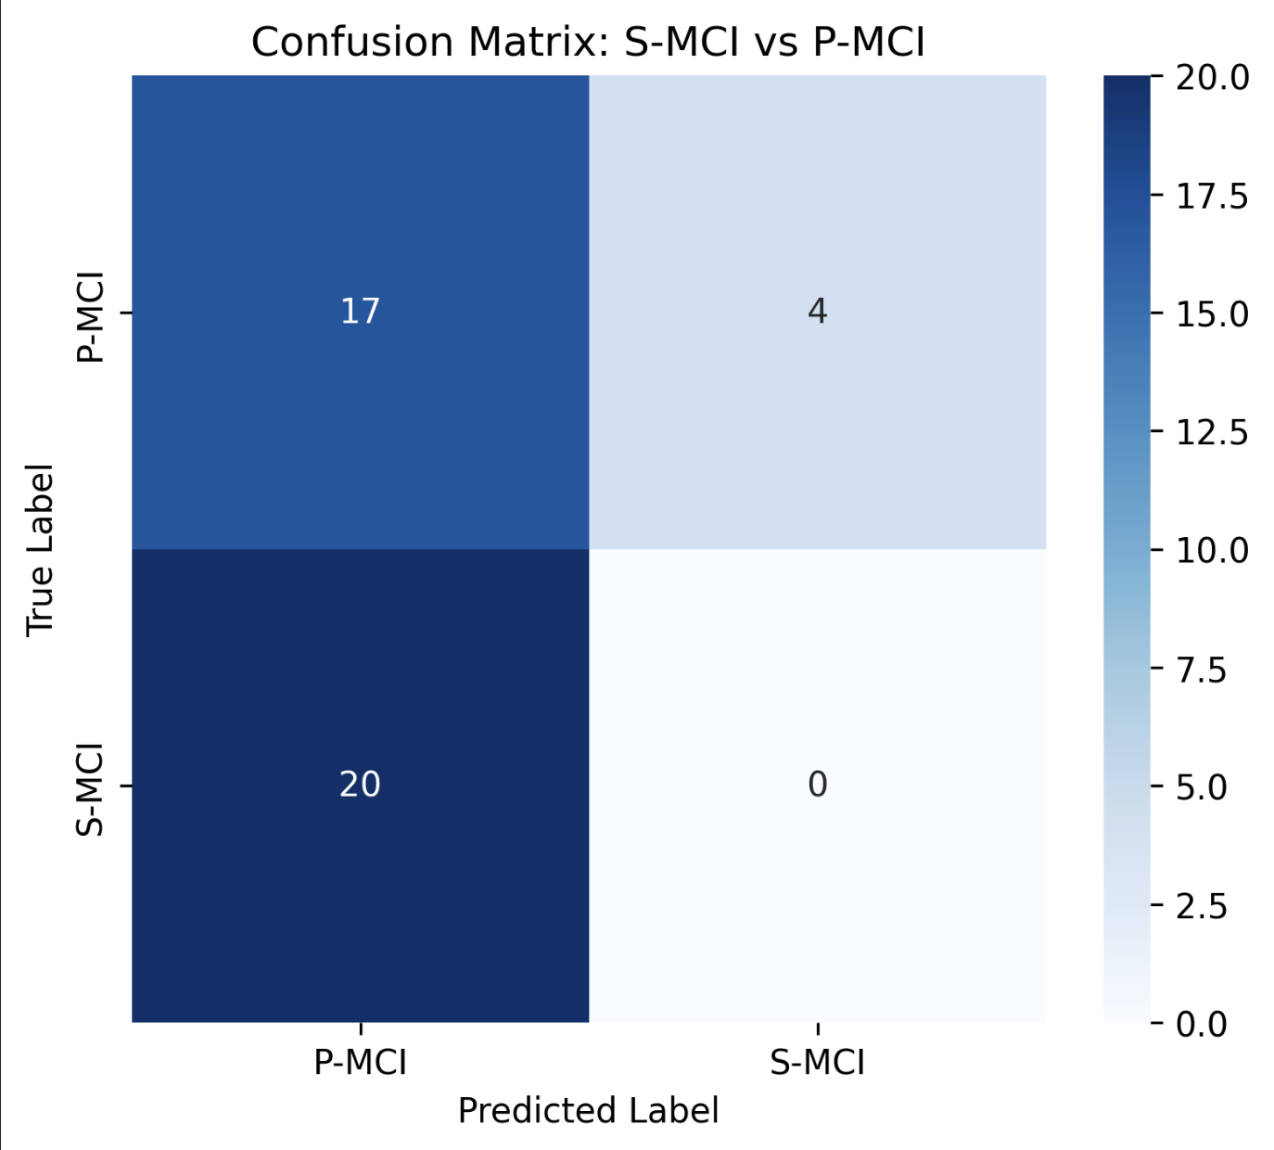
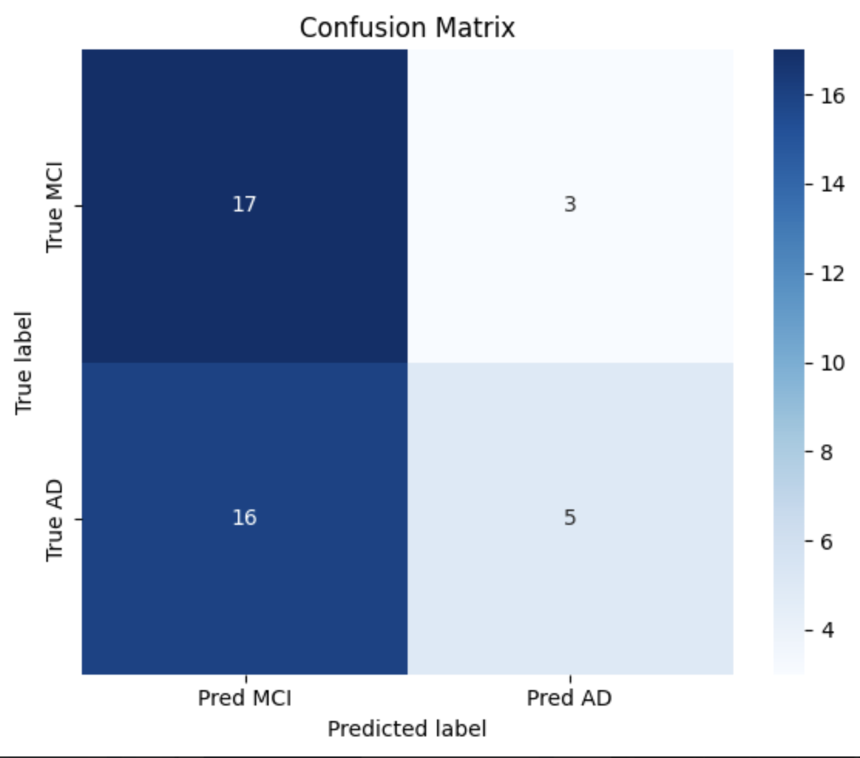
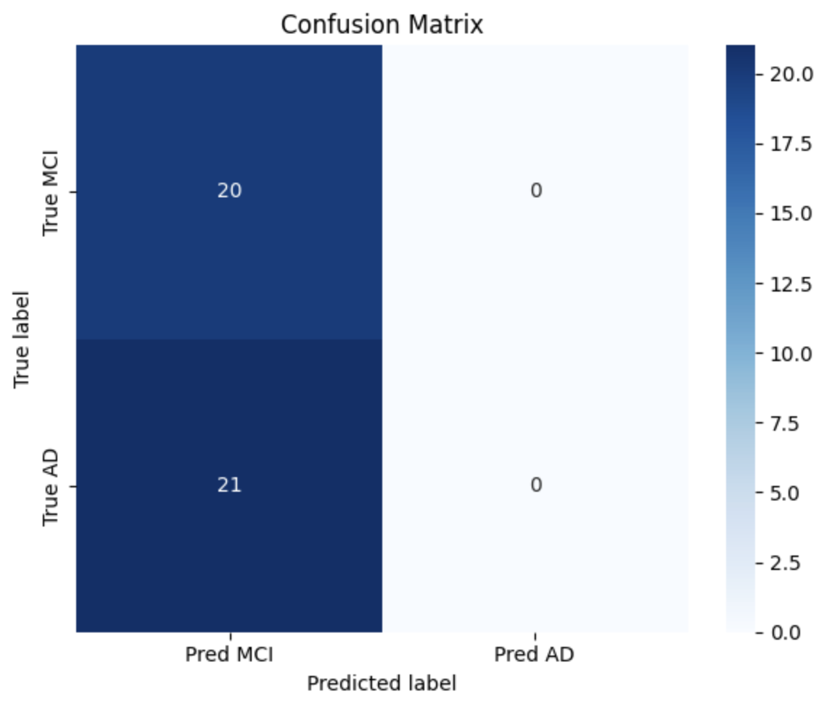



Results
Confusion Matrix on External cohort
SVM
1D-CNN
2D-CNN

Slide 10
Results
Evaluation Performances
 | SVM | 1D-CNN | 2D-CNN
Accuracy | 41.46% | 53.66% | 48.78%
Sensitivity | 80.95% | 23.81% | 0%
Specificity | 0% | 85% | 100%

Slide 11
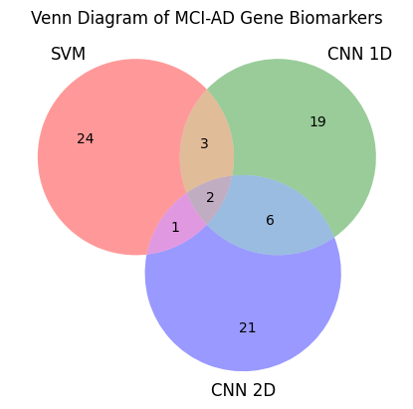
Results
Venn Diagram of top 30 genes biomarker
SVM
1D-CNN
IGKV2D-29
FAM118A
Predicted to be involved in the immune response, which is in the extracellular region and plasma membrane as a part of the immunoglobulin complex.
Predicted to be located in the membrane to enable identical protein binding activity.
2D-CNN

Slide 12
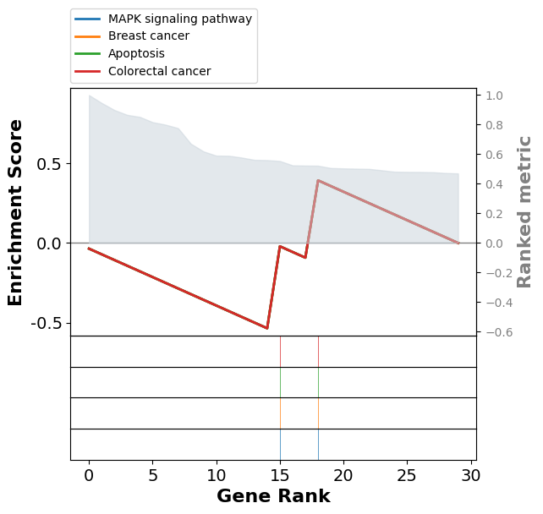
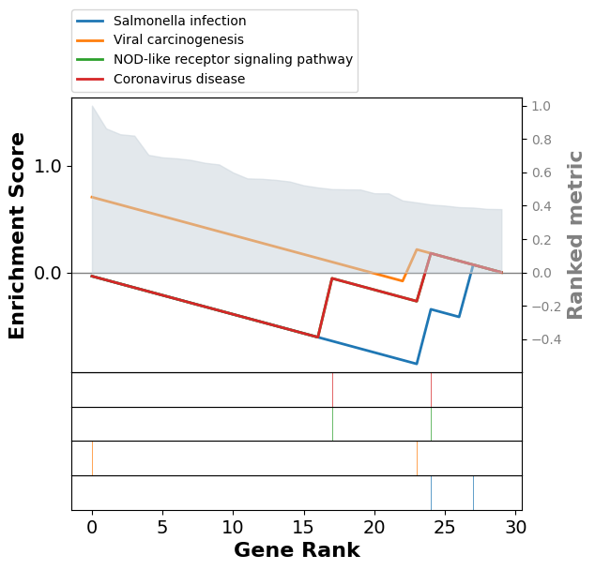
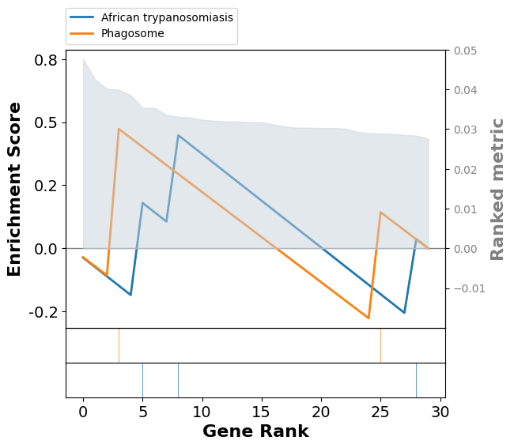
Results
GSEA with top 30 genes
SVM
1D-CNN
2D-CNN
Notes:
Gene set enrichment analysis (GSEA)

Slide 13
Conclusion
Aim 1: Identify a set of gene expression biomarkers for high-risk and low-risk MCI to AD dementia prognosis
What we found: Fam118A and IGKV2D-29 are two biomarkers that we can use to categorize MCI to AD dementia prognosis
Aim 2: Compare the performance of predictive models between machine learning and deep learning approaches
What we found: After comparing evaluation performances, 1D-CNN is likely the best model to use, but features from the SVM and 2D-CNN models can be incorporated to improve model accuracy, sensitivity, and specificity

Slide 14
References
Mian M, Tahiri J, Eldin R, Altabaa M, Sehar U, Reddy PH. Overlooked cases of mild cognitive impairment: Implications to early Alzheimer's disease. Ageing Res Rev. 2024 Jul;98:102335. doi: 10.1016/j.arr.2024.102335. Epub 2024 May 12. PMID: 38744405; PMCID: PMC11180381.
Petersen RC. Mild cognitive impairment as a diagnostic entity. J Intern Med. 2004 Sep;256(3):183-94. doi: 10.1111/j.1365-2796.2004.01388.x. PMID: 15324362.
Di Costanzo A, Paris D, Melck D, Angiolillo A, Corso G, Maniscalco M, et al. Blood biomarkers indicate that the preclinical stages of Alzheimer’s disease present overlapping molecular features. Sci Rep. 2020;10:15612.
Li X, Wang H, Long J, Pan G, He T, Anichtchik O, et al. Systematic analysis and biomarker study for Alzheimer’s disease. Sci Rep. 2018;8:17394.
Karaman BK, Mormino EC, Sabuncu MR. Machine learning based multi-modal prediction of future decline toward Alzheimer’s disease: an empirical study. PLoS ONE. 2022;17:e0277322.
Mian M, Tahiri J, Eldin R, Altabaa M, Sehar U, Reddy PH. Overlooked cases of mild cognitive impairment: Implications to early Alzheimer's disease. Ageing Res Rev. 2024 Jul;98:102335. doi: 10.1016/j.arr.2024.102335. Epub 2024 May 12. PMID: 38744405; PMCID: PMC11180381.
Huang YL, Tsai TH, Shen ZQ, Chan YH et al. Transcriptomic predictors of rapid progression from mild cognitive impairment to Alzheimer's disease. Alzheimers Res Ther 2025 Jan 3;17(1):3. PMID: 39754267
Iga JI, Yoshino Y, Ozaki T, Tachibana A, Kumon H, Funahashi Y, Mori H, Ueno M, Ozaki Y, Yamazaki K, Ochi S, Yamashita M, Ueno SI. Blood RNA transcripts show changes in inflammation and lipid metabolism in Alzheimer's disease and mitochondrial function in mild cognitive impairment. J Alzheimers Dis Rep. 2024 Dec 23;8(1):1690-1703. doi: 10.1177/25424823241307878. PMID: 40034360; PMCID: PMC11863738.
T. Khorshed, M. N. Moustafa and A. Rafea, "Deep Learning for Multi-Tissue Cancer Classification of Gene Expressions (GeneXNet)," in IEEE Access, vol. 8, pp. 90615-90629, 2020, doi: 10.1109/ACCESS.2020.2992907
Mostavi M, Chiu YC, Huang Y, Chen Y. Convolutional neural network models for cancer type prediction based on gene expression. BMC Med Genomics. 2020 Apr 3;13(Suppl 5):44. doi: 10.1186/s12920-020-0677-2. PMID: 32241303; PMCID: PMC7119277.

